Slide 1
Fundamentals of Networks and Security
Markos Vassilis
Mediterranean College
Week 02

Slide 2
A Quick Catch-up First…

Slide 3
Quick Revision… 1 / n
What is “The Internet”?
A network of networks: a Layer 3 network where local networks are interlinked to each other, using appropriate addressing for each local network. Often referred to as a WAN (Wide Area Network).
Why not connect all devices with one another in a device network?
Because this would result in an immense number of connections, leading to increased setup, running and maintenance costs.
What is a prerequisite for the utilisation of a Layer 2 switch?
Each device should have a unique name in order to be recognized by the switch.

Slide 4
Quick Revision… 2 / n
What is a MAC (Media Access Control) Address?
A MAC address is a unique address assigned to any device connected to a Local Area Network (LAN).
What is the difference between a “Hub” and a “Layer 2 switch”?
The hub does not distinguish between the devices connected to it, letting information flow towards all devices in a network and, thus, increasing the chance of collision. Layer 2 switches avoid that by remembering which port is (physically) connected to which device (through the devices’ MAC addresses).
What is the plural of LAN?
The plural of LAN is still LAN, since acronyms are both singular and plural number.

Slide 5
Quick Revision… 3 / n
What is a Router?
A Router is a device which interlinks many different LAN in a way similar to which a Layer 2 switch does with devices within a LAN (similarities appear just at the abstract level, though!).
What is an IP (Internetwork Protocol)?
An IP is essentially “the way” in which a Router manages to properly handle the flow of signals (information) throughout an interlinked network of LAN.
Right or Wrong? Networking done through a Layer 2 switch is subject to changes.
Wrong. Layer 2 switches rely on physical connectivity, thus they are not amenable to changes, but for the case when / where the physical connections between network devices change.

Slide 6
Quick Revision… 4 / n
Right or Wrong? Layer 3 networking is amenable to changes.
Right. Layer 3 is implemented at the logical level, i.e., based on our views on how things “should” be, and does not rely on the physical connections between networks and / or network devices.
What’s the difference between “The Internet” and the WWW?
The term “Internet” refers to interlinked local networks that build up a wider network, while “WWW” refers to the information that is kept in and flows through that network.
Mention some ways of network protection.
Some network security techniques include but don’t restrict to: Firewalls, Network Segmentation, Remote access VPN and other techniques that mostly rely on Layer 4.

Slide 7
More About Networks

Slide 8
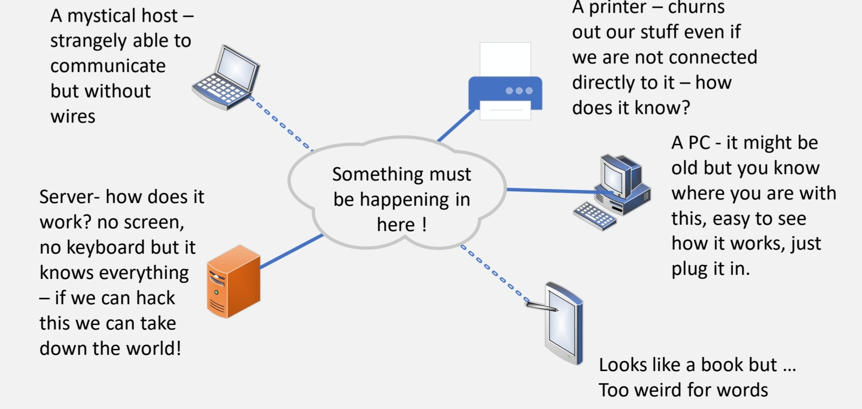
A Typical Network

Slide 9
Have you heard of these?
Host: Something (aka a device) that holds some information / data (photos, videos, documents etc).
Client: A device that utilises information or services provided by something else (i.e., a provider).
Server: Something that provides a service (e.g., data or data processing, fetching remotely stored information). Typically, the term refers to the software implementing the service, however we often use the term for the box in which the software lives (aka the hardware).
Peers: Two or more things living and / or acting at the same level, e.g. you, co-workers, devices with the same status in a network etc.

Slide 10
Clients and Servers 1 / n
The most obvious way to organise devices in a network?
As clients and servers:
Servers offer services and the corresponding software is usually loaded on a server optimised machine (aka the server) but Thurs may well not be the case
Clients consume the services offered by servers.
Can you imagine of potential benefits and drawbacks of such designs?
Well, this is part of this week's homework… ;)
Can a device be both a client and a server?
Stay tuned…

Slide 11
Clients and Servers 2 / n
The case of printers:
Old school printers were physically connected to whichever device needed them though old school cables (RS232 serial cables or parallel ones). Every character was steamed separately.
Modern printers are connected to a network of devices which intend to use them. Any device that wishes and knows how to, can talk to a network printer.
How is the software installed on each interested device that interfaces with the printer called?
Driver software.

Slide 12
Clients and Servers 3 / n
More on the almighty “networked” printers :
What is a printer in a network: a client or a server?
A client. But, then, who is the server in this use case?
The so-called printing queue:
“printing” because it provides printers with documents to print;
“queue" because it puts documents in order for the printer to consume them, so that more than one devices can communicate with it (the printer) at the same time.

Slide 13
Clients and Servers 4 / n
How can the printer and the printing queue interact?
The server can send the data directly to the printer (using a specific and often purpose specific address within the network). This is called a push because we push the data to the client.
But, what if we pretend to be the printer?
Alternatively, the printer can be logged into the network and then pull the data where it is. This is called a pull.
Can we now pretend to be the printer?

Slide 14
Clients and Servers 5 / n
Some wireless terms:
Wireless Access Points (WAP): Extend the local network to wireless clients. They require at least one physical connection.
Wireless Routers: Connect local clients to different networks. Again, they require at least one physical connection.
Wireless Extenders: Receive and transmit the signal to other devices in the network (yet, really slow most of the times).

Slide 15
Peer to Peer Networks
Can a device act both as a server and as a client?
Of course it can!
Peer-to-Peer (P2P): In such networks every device acts sometimes as a provider / broadcaster (“server”) and sometimes as a receiver (“client”).
Use cases of P2P networks:
File sharing (e.g., BitTorrent, qBitTorrent)
Blockchain technologies
(Actually) anonymous browsing (e.g., Tor browser)
Can you imagine of potential benefits and drawbacks of such designs?
Of course, this is also part of your homework…

Slide 16
Network Layouts
While networks might vary in size (e.g., home, office, corporate networks) they all share some similar constructs:
Some client devices
Some connections between those clients
Some servers
Some sort of connection to the wild west of all other networks.
Remember, in principle, “connecting devices” serve the same purpose but utilising different means (e.g., Layer 2 switches vs Routers).
Most of the above constructs are “inside” the network, but not all (e.g., a server is not usually part of the “inside” of a home network).

Slide 17
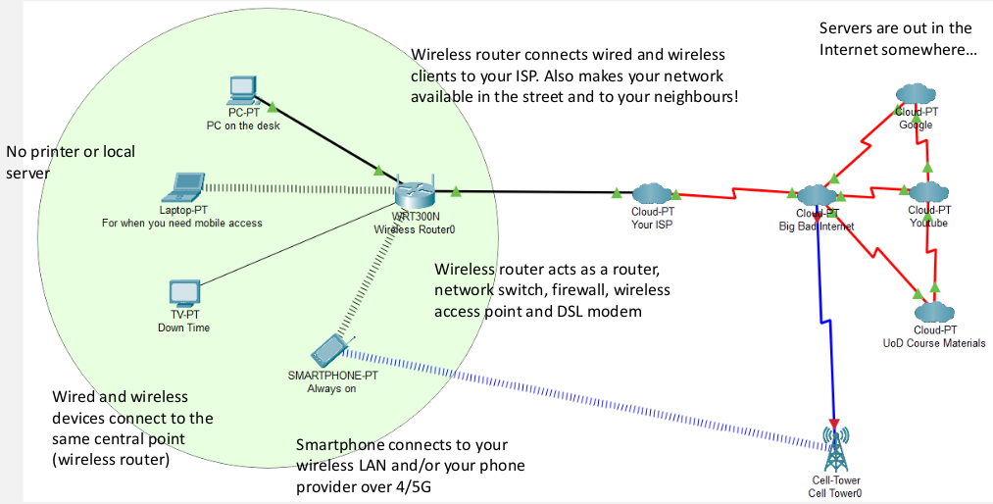
Home Networks 1 / n

Slide 18
Home Networks 2 / n
No local server (but local services are there).
The wireless router has a central role, “distributing the network”.
The wireless router makes your network accessible to a certain area around it.
No user authentication.
Wireless devices have one common fixed password but no usernames.
All services are provided by third-parties, however it all seems to be part of your network (e.g., Google).

Slide 19
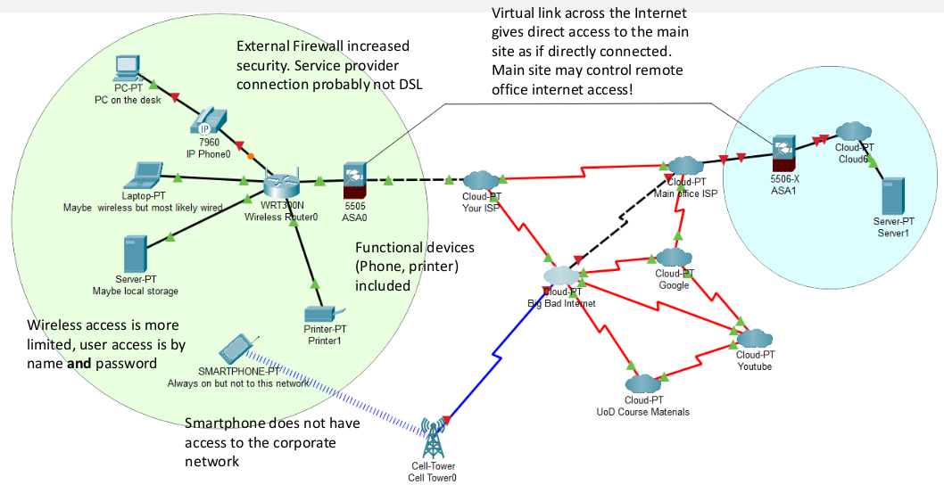
Remote Office Networks 1 / n

Slide 20
Remote Office Networks 2 / n
May include local server.
Services come from company servers (not from anywhere around the Internet).
Device authentication.
User authentication by ID and password to join.
Probably fixed router + WAP than wireless router.
External firewall (>> security).
Active network monitoring and maintenance.
Overall, it appears as split between “the in-company” and “the out-company” networks.

Slide 21
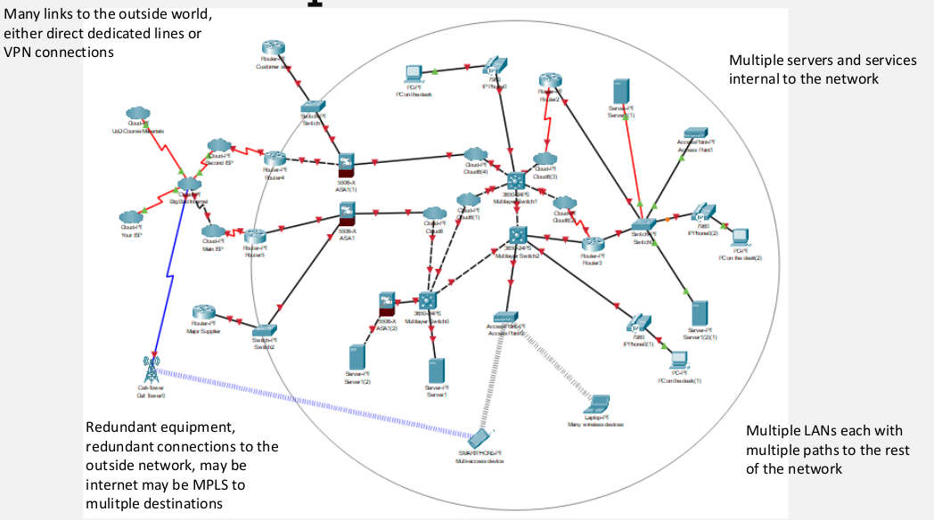
Corporate Networks 1 / n

Slide 22
Corporate Networks 2 / n
Many private servers
Device authentication
User authentication by ID and password
WAP + Routers instead of purely wireless routers.
External firewalls + internal firewalls.
Active network monitoring and maintenance.
Overall, appears to be split into a major “company” network and a minor “off site” one.
What do all three have in common? All devices need to somehow communicate!

Slide 23
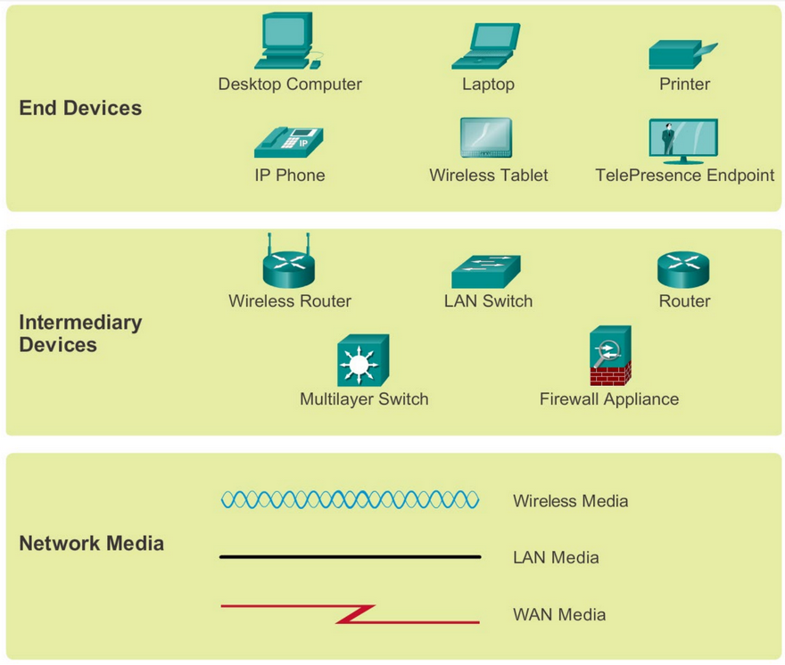
Addendum: Common Network Symbols

Slide 24
What we saw today… 1 / n
Provide definitions for the following terms: Client, Host, Server, and Peer.
Client: The one who utilises data / services. Host: The one that keeps data / information. Server: The one the provides data / services. Peer: Someone at the same level to someone else.
Briefly describe how a client-server network works.
The servers offer services to the clients which, in term, use these services (essentially, the network is split to providers and consumers).

Slide 25
What we saw today… 2 / n
What is a driver?
Software that is installed on each interested device within a network that interfaces with a target device (which corresponds to the driver).
What is a “Push”?
A “push” is the action of sending data directly from the server to a client, using the latter’s unique identifier (e.g., MAC address in a LAN network).
What is a “Pull”?
A “pull” is the action of accessing data from where they are kept by logging into a network.

Slide 26
What we say today… 3 / n
Is a Wireless Router the same as a WAP?
No, the wireless router creates a WAP, i.e., it enables us to connect to a network wirelessly, but a WAP is nothing more than that (i.e., it cannot perform any sort of routing).
Can a device act both as a client and as a server? If yes, name some use cases of such architectures.
Indeed, such networks where devices act as both providers and consumers are called Peer-to-Peer (P2P) networks and they are utilised in Blockchain, anonymous browsing, file-sharing etc.

Slide 27
What we saw today… 4 / n
Name three examples of networks of different scale.
Home networks < Remote office networks < Corporate networks.
Regardless of network size, what is a common underlying principle for all networks?
All devices within the network must communicate in some way.
What is the recency effect in cognitive psychology?
When asked to recall items of a list in any order, people tend to remember the last members of the list better than the rest. This is called the recency effect. For more: https://en.wikipedia.org/wiki/Serial-position_effect

Slide 28
Homework
Consider Client-Server and P2P network designs. Using any resources you wish (which you should cite, of course), write a 300-400 words essay (or more) about:
the benefits and drawbacks of each design paradigm;
how they compare;
some examples where client - server designs are preferred over P2P ones and vice versa.
The word limit of 300 words is hard (meaning you should right at least 300 words) while you can exceed 400 words if you feel struck by inspiration.
Send your work at: v.markos@mc-class.gr

Slide 29
(Reminder) NetAcad Courses
In the “Download Packet Tracer” page, above the “Download” section, you can find three interesting courses (interesting course: a course is characterised as “interesting” to inform someone that they should take it, without telling them to do so directly):
Getting Started with Cisco Packet Tracer
Exploring Networking with Cisco Packet Tracer
Exploring IoT with Cisco Packet Tracer
Also interesting is the following NetAcad course:
Network Technician

Slide 30
Fun Time!

Slide 31
Packet Tracer
Have you completed all previous lab exercises? If not:
Open 1.5.4 Lab - My Local Network.pdf and follow the instructions there.
Open 3.3.3 Packet Tracer - Deploy Devices.pdf and follow the instructions there. You will also need 3.3.3 Packet Tracer - Deploy Devices.pka.
Open 3.3.4 Packet Tracer - Deploy and Cable Devices.pdf and follow the instructions there. You will also need 3.3.4 Packet Tracer - Deploy and Cable Devices.pka.

Slide 32
Introduction to WireShark
Open Kurose and Ross - Wireshark_Intro_v8.0.pdf and follow the instructions therein.
Enjoy yourselves.

Slide 33

Any Questions?
Don’t forget to fill-in the questionnaire! (look right)
https://forms.gle/6q2tuByroaan8kWH8

